Slide 1

Big Data with Azure What’s New and What’s on the Roadmap
James Serra
Big Data Evangelist
Microsoft
JamesSerra3@gmail.com

Slide 2

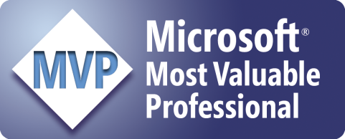
About Me
Microsoft, Big Data Evangelist
In IT for 30 years, worked on many BI and DW projects
Worked as desktop/web/database developer, DBA, BI and DW architect and developer, MDM architect, PDW/APS developer
Been perm employee, contractor, consultant, business owner
Presenter at PASS Business Analytics Conference, PASS Summit, Enterprise Data World conference
Certifications: MCSE: Data Platform, Business Intelligence; MS: Architecting Microsoft Azure Solutions, Design and Implement Big Data Analytics Solutions, Design and Implement Cloud Data Platform Solutions
Blog at JamesSerra.com
Former SQL Server MVP
Author of book “Reporting with Microsoft SQL Server 2012”

Slide 3
Agenda
Azure Analysis Services
Azure Databricks
Cosmos DB
Azure SQL Database Managed Instance
Azure Data Factory v2
Notes:
Azure Database for MariaDB, PostgreSQL, MySQL
Azure Cosmos DB with Apache Cassandra API (MongoDB)
Azure time series
Cognitive Services, Bots

Slide 4
Azure Analysis Services

Slide 5
SSAS/Azure Analysis Services Cubes
Reasons to report off cubes instead of the data warehouse:
Semantic layer
Handle many concurrent users
Aggregating data for performance
Multidimensional analysis
No joins or relationships
Hierarchies, KPI’s
Security
Advanced time-calculations
Slowly Changing Dimensions (SCD)
Required for some reporting tools
Notes:
Question: How many people know what SSAS cubes are?

Slide 6

Comprehensive Microsoft BI offerings Hybrid architecture
Model
Analyze & Author
Deliver
Visualize
DATA
Azure Analysis Services
Azure Analysis Services
Power BI
Power BI
Mobile
Cloud
On–premises data gateway
On-premises
Web
DATA
SQL Server
Analysis Services
SQL Server Reporting Services
Excel
Power BI Desktop
Embedded in your apps
Notes:
This overview shows that Microsoft has been delivering BI capabilities to help customers model, analyze, and deliver business insights, which can be consumed by business users on mobile devices, on the web or embedded in apps. Most capabilities have been available on-premises with SQL Server Analysis Services and Reporting Services as well as Power BI Desktop and Excel.
In the cloud, we were primarily relying on Power BI to deliver business insights – with data connections to many cloud data sources and SaaS apps. In addition to cloud data sources customers can access on-premises data sources such as SQL Server Analysis Services using the on-premises data gateway.
To help customers analyze high volumes of data, which might already be stored in the cloud, for example in an Azure SQL Data Warehouse, we are now enabling BI semantic data modeling capabilities in the cloud.
Azure Analysis Services, is based on the proven analytics engine in SQL Server 2016 Analysis Services. Customers can access data sources across on-premises and the cloud, model that data, and provide business users with a simplified view of their data to enable interactive self-service BI and data discovery using their preferred data visualization tool.
Let’s take a look at the benefits of Azure Analysis Services

Slide 7
Azure Analysis Services
Enterprise grade analytics engine as a service
Build rich semantic models
Transform complex data into business user friendly semantic models
Gain insights at the speed of thought
Gain instant insights with in-memory cache using your preferred visualization tools
Proven technology
Based on powerful, proven SQL Server Analysis Services
Provision and scale with ease
Easy to deploy, scale, and manage as platform-as-a-service
Notes:
Key points: Summarize key benefits for Azure Analysis Services
Azure Analysis Services helps you transform complex data from different data sources into a BI semantic model, so users in your organization can easily gain insights by connecting to the data models using tools like Excel, Power BI, and others to create reports and perform ad hoc data analysis
Talk Track
Transform Complex Data into rich BI semantic models: Azure Analysis Services Analysis Services helps you transform complex data into a single business user friendly data model making it easy for business users to understand and analyze data across different data sources.
Gain instant insights with in-memory cache using your preferred visualization tools : Not only can business users get insights from data easily using their preferred data visualization tool, whether it is Power BI, Excel or other major data visualization tools, but with the in-memory cache capabilities of Azure Analysis Services, users can gain insights over billions of rows of data at the speed of thought
Proven Technology: Azure Analysis Services is based on the proven analytics engine in SQL Server 2016 Analysis Services, that has helped organizations turn complex data into a trusted, single source of truth for years. This means that BI professionals who are familiar with SQL Server Analysis Services, tabular models can get started quickly and do not need to learn new tools or skills.
Analytics engine as-a-service (provision fast, scale faster): The same proven enterprise grade BI platform is now available as a fully managed service in Azure. With the power of the trusted Microsoft Cloud, you do not need to manage infrastructure on-premises and can benefit from the scalability of the cloud. Additionally you can use Azure Resource Manager to create and deploy an Azure Analysis Services instance within seconds, and use backup restore to quickly move your existing models to Azure Analysis Services and take advantage of the scale, flexibility and management benefits of the cloud. Scale up, scale down, or pause the service and pay only for what you use.
Azure Analysis Services is built for Hybrid BI - Organizations store data in the cloud and on-premises. Azure Analysis Services is built for hybrid data. Data can be access in the cloud, on-premises or a combination of both, enabling a hybrid solution. So - you do not have to move on-premises data to the cloud.
To summarize, Azure Analysis Services is simple to use – it is easy to get started, you can use your existing skills to create BI semantic models, and your favorite data visualizations tools to analyze your data.

Slide 8
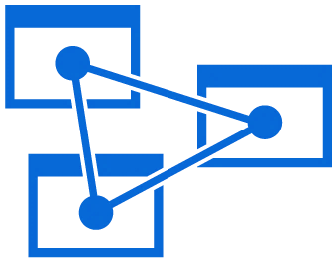
Rich semantic modeling Transform complex on-premises or cloud data into insights
DATA
Model complex data into business user friendly semantic datasets
Combine into a single model for one version of the truth
Build scalable solutions over billions of rows of data
Deliver trusted data models that business users can easily understand
Transform data into rich BI semantic models
Cloud
On-premises
Azure Analysis Services
DATA
Notes:
Azure Analysis Services Analysis Services helps you transform complex data into a single business friendly data model making it easy for business users to understand and analyze data across different data sources.
The success of any modern data-driven organization requires that information is available at the fingertips of every business user, not just IT professionals and data scientists, to guide their day-to-day decisions. Self-service BI tools have made huge strides in making data accessible to business users. However, most business users don’t have the expertise or desire to do the heavy lifting that is typically required, finding the right sources of data, importing the raw data, transforming it into the right shape, and adding business logic and metrics, before they can explore the data to derive insights. With Azure Analysis Services, a BI professional can create a semantic model over the raw data and share it with business users so that all they need to do is connect to the model from any BI tool and immediately explore the data and gain insights

Slide 9
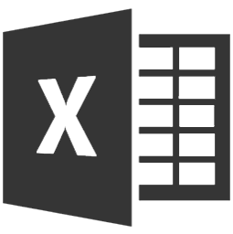
Insights at the speed of thought Gain instant insights using your preferred visualization tools
Empower your business users with familiar data visualization tools like Power BI, Excel, and others
Enable users to explore data and gain insights instantly with in-memory cache
Extend the value of your existing data
Access virtually any data—wherever it is
Explore models using visualization tools and gain instant insights
Azure Analysis Services
Notes:
Key points:
Easily analyze data with familiar, preferred data visualization tools and in-memory cache Azure Analysis Services enables instant delivery of insights
Talk Track:
Whether business users use Power BI, Excel or other 3rd party tools they don’t have to worry about transforming and cleansing the data, or identifying relationships across disparate data sources. By accessing a pre-built data model, all users can access a consistent view of the data. This means that organizations can easily extend the value of your existing data and access virtually any data wherever it is.
With the in-memory cache capabilities of Azure Analysis Services, users can gain insights over billions of rows of data at the speed of thought

Slide 10
Proven analytics engine Azure Analysis Services is based on SQL Server technology
Data sources
BI semantic model
Client tools
DATA
MDX
DAX
TOOLS
Queries
Tabular model
Data model
Cloud
Cloud
On-premises
DAX calculations
On-premises
DATA
Business logic
TOOLS
In-memory
DirectQuery
Data access
Notes:
Key points:
Azure Analysis Services works just like SQL Server Analysis services (for tabular models), supports data sources on-premises and in the cloud, and consume using your preferred data visualization tools.
Talk track:
Azure Analysis Services is based on SQL Server 2016 Analysis Services technology. Data can be accessed on-premises and in the cloud and business users and BI professionals can consume the data on-mobile devices, on the web and in custom apps.
This means that BI professionals who are familiar with SQL Server Analysis Services, tabular models can get started quickly and do not need to learn new tools or skills.
That includes the flexibility to develop in the familiar Visual Studio environment and take advantage of Visual Studio Application Lifecycle Management

Slide 11
Platform-as-a-service solution All the benefits of the cloud in your analytics engine
Get started quickly
Spin up a new server in seconds without managing the infrastructure
Provide secured access
From virtually anywhere
Rely on Microsoft’s experience running trusted enterprise cloud services
Access data when you need it
99.9% availability
Scale up, down, and pause
Only pay for what you need
Azure Analysis Services
Notes:
Key points:
Proven analytics engine with the benefits of the cloud.
Talk track:
And by moving to the cloud customers can get started quickly, it takes only seconds to spin up a server.
With 99.9% availability data can be accessed when needed, and secured access to data can be provided from virtually anywhere.
Customers can also pause the service to only pay for what they use. With the ability to scale the service up and down –customers get the performance they need when needed.
With Azure Analysis Services customers, can rely on Microsoft’s experience running trusted enterprise cloud services!
include message around move your existing models with the new backup and restore feature

Slide 12




Azure Analysis Service tiers Select tier based on your needs
…
D1 Developer
B1 Basic
B2 Basic
S0 Standard
S4 Standard
20 Query Processing Units
40 Query Processing Units
80 Query Processing Units
40 Query Processing Units
400 Query Processing Units
Up to 3 GB Cache
Up to 10 GB Cache
Up to 20 GB Cache
Up to 10 GB Cache
Up to 100 GB Cache
Shared infrastructure
Dedicated service
Dedicated service
Dedicated service
Dedicated service
SSL
SSL
SSL
SSL
SSL
SSL
For test and development only
99.9 % SLA at general availability
99.9 % SLA at general availability
99.9 % SLA at general availability
99.9 % SLA at general availability
Feature Additions
Partitions
Partitions
Partitions
Note: For the latest pricing go to https://azure.microsoft.com/en-us/pricing/details/analysis-services/
Notes:
Key Points: Provides a quick overview of available service tiers. Azure Analysis Services service tiers include Developer, Basic and Standard. Each tier is distinguished primarily by its overall performance, which is measured in QPUs (Query Processing Units).
Standard and developer tiers are further differentiated by the availability of the Partition feature that provides customers advanced data refresh controls
For latest pricing go to the pricing page.

Slide 13

Azure Analysis Services Architecture
Cloud visualization tools
Cloud data sources
Azure Analysis Services
SQL Database
Other data sources
Power BI
Direct Query
SQL Data Warehouse
Cached Model
Power BI Embedded
Gateway
On-premises data sources
Authoring and development tools
On-premises visualization tools
SQL Server
Other data sources
Visual Studio
Excel
Direct Query
Analytics Platform System
Teradata
Oracle
Cached Model
Power BI Desktop
Third party BI tools
Note: not all capabilities available at public preview
Notes:
This is a high-level architecture view.
Analysis Services is now part of the cloud solution. If your data sources are all in the cloud such as Azure SQL DW and SQL Database, no on-premises infrastructure is required. Client such as Power BI Desktop, Excel, and 3rd party tools connect directly to the cloud. For Azure Analysis Services to access on-premises data sources, the On-premises data gateway is required. One per Analysis Services server is required to support the volume and performance requirements of the Azure Analysis Services workload.

Slide 14
Azure Analysis Services Azure Analysis Services is based on SQL Server technology
Data sources
BI semantic model
Client tools
Cloud
Cloud
SQL Database
Security
SQL Data Warehouse
Data modeling
Power BI
Other data sources
Queries
Power BI Embedded
On-premises
On-premises
Azure Analysis Services
SQL Server
Power BI Desktop
Analytics platform system
Excel
Lifecycle management
Business logic & metrics
Other data sources
Third party BI tools
Notes:
Key points:
Azure Analysis Services works just like SQL Server Analysis services (for tabular models), supports data sources on-premises and in the cloud, and consume using your preferred data visualization tools.
Talk track:
Azure Analysis Services is based on SQL Server 2016 Analysis Services technology. In preview, we are focusing on tabular models only. Data can be accessed on-premises and in the cloud and business users and BI professionals can consume the data on-mobile devices, on the web and in custom apps.
This means that BI professionals who are familiar with SQL Server Analysis Services, tabular models can get started quickly and do not need to learn new tools or skills.
Develop in the familiar Visual Studio environment and take advantage of Visual Studio Application Lifecycle Management

Slide 15
Azure Databricks

Slide 16





POSITIONING THE DIFFERENT BIG DATA SOLUTIONS
KNOWING THE VARIOUS BIG DATA SOLUTIONS
CONTROL
EASE OF USE
Azure Data Lake
Analytics
Data Engineering in a
Job-as-a-service model
Azure Databricks
Frictionless & Optimized Spark clusters
Azure HDInsight
Workload optimized, managed clusters
Reduced Administration
Azure Marketplace
HDP | CDH | MapR
BIG DATA ANALYTICS
Any Hadoop technology, any distribution
IaaS Clusters
Managed Clusters
Big Data as-a-service
Azure Data Lake Analytics
Azure Data Lake Store
BIG DATA STORAGE
Azure Storage

Slide 17

Big Data & Advanced Analytics at a glance
Ingest
Store
Prep & Train
Model & Serve
Intelligence
Business apps
Data Factory
(Data movement, pipelines & orchestration)
Cosmos DB
Predictive apps
Blobs
Data Lake
Databricks
HDInsight
Data Lake Analytics
SQL
Custom apps
Kafka
10 01
SQL Database
SQL Data Warehouse
Operational reports
Event Hub
IoT Hub
Machine Learning
Sensors and devices
Analysis Services
Analytical dashboards
Notes:
Azure build-out of DMSA. Supports hybrid\on-premises too through ADF \ Blob \ Stretch.

Slide 18

Why Spark?
Open-source data processing engine built around speed, ease of use, and sophisticated analytics
In memory engine that is up to 100 times faster than Hadoop
Largest open-source data project with 1000+ contributors
Highly extensible with support for Scala, Java and Python alongside Spark SQL, GraphX, Streaming and Machine Learning Library (Mllib)
Notes:
When it comes to ease of use, Spark again happens to be a lot better than Hadoop. Spark has APIs for several languages such as Scala, Java and Python, besides having the likes of Spark SQL. It is relatively simple to write user-defined functions. It also happens to boast an interactive mode for running commands. Hadoop, on the other hand, is written in Java and has earned the reputation of being pretty difficult to program, although it does have tools that assist in the process. (To learn more about Spark, see How Apache Spark Helps Rapid Application Development.)
In-Memory Technology
One of the unique aspects of Apache Spark is its unique "in-memory" technology that allows it to be an extremely good data processing system. In this technology, Spark loads all of the data to the internal memory of the system and then unloads it on the disk later. This way, a user can save a part of the processed data on the internal memory and leave the remaining on the disk.
Spark also has an innate ability to load necessary information to its core with the help of its machine learningalgorithms. This allows it to be extremely fast.
Spark’s Core
Spark’s core manages several important functions like setting tasks and interactions as well as producing input/output operations. It can be said to be an RDD, or resilient distributed dataset. Basically, this happens to be a mix of data that is spread across several machines connected via a network. The transformation of this data is created by a four-step method, comprised of mapping the data, sorting it, reducing it and then finally, joining the data.
Following this step is the release of the RDD, which is done with support from an API. This API is a union of three languages: Scala, Java and Python.
Spark’s SQL
Apache Spark’s SQL has a relatively new data management solution called SchemaRDD. This allows the arrangement of data into many levels and can also query data via a specific language.
Graphx Service
Apache Spark comes with the ability to process graphs or even information that is graphical in nature, thus enabling the easy analysis with a lot of precision.
Streaming
This is a prime part of Spark that allows it to stream large chunks of data with help from the core. It does so by breaking the large data into smaller packets and then transforming them, thereby accelerating the creation of the RDD.
MLib – Machine Learning Library
Apache Spark has the MLib, which is a framework meant for structured machine learning. It is also predominantly faster in implementation than Hadoop. MLib is also capable of solving several problems, such as statistical reading, data sampling and premise testing, to name a few.

Slide 19
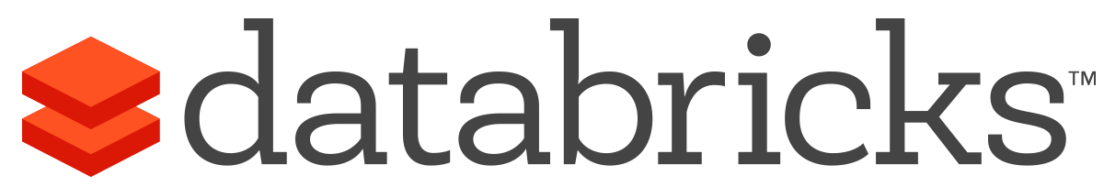

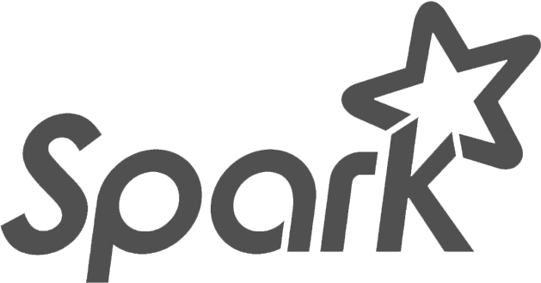
What is Azure Databricks?
A fast, easy and collaborative Apache® Spark™ based analytics platform optimized for Azure
Best of Databricks
Best of Microsoft
Designed in collaboration with the founders of Apache Spark
One-click set up; streamlined workflows
Interactive workspace that enables collaboration between data scientists, data engineers, and business analysts.
Native integration with Azure services (Power BI, SQL DW, Cosmos DB, Blob Storage)
Enterprise-grade Azure security (Active Directory integration, compliance, enterprise-grade SLAs)
Notes:
Azure Databricks features –
Enhance your teams’ productivity
Get started quickly by launching your new Spark environment with one click.
Share your insights in powerful ways through rich integration with PowerBI.
Improve collaboration amongst your analytics team through a unified workspace.
Innovate faster with native integration with rest of Azure platform.
Build on the most compliant and trusted cloud
Simplify security and identity control with built-in integration with Active Directory.
Regulate access with fine-grained user permissions to Azure Databricks’ notebooks, clusters, jobs and data.
Build with confidence on the trusted cloud backed by unmatched support, compliance and SLAs.
Scale without limits
Operate at massive scale without limits globally.
Accelerate data processing with the fastest Spark engine.

Slide 20
Differentiated experience on Azure
ENHANCE PRODUCTIVITY
BUILD ON THE MOST COMPLIANT CLOUD
SCALE WITHOUT LIMITS
Get started quickly by launching your new Spark environment with one click.
Share your insights in powerful ways through rich integration with Power BI.
Improve collaboration amongst your analytics team through a unified workspace.
Innovate faster with native integration with rest of Azure platform
Simplify security and identity control with built-in integration with Active Directory. Regulate access with fine-grained user permissions to Azure Databricks’ notebooks, clusters, jobs and data.
Build with confidence on the trusted cloud backed by unmatched support, compliance and SLAs.
Operate at massive scale without limits globally.
Accelerate data processing with the fastest Spark engine.
Notes:
Databricks, founded by the team that created Apache Spark – unified analytics platform that accelerates innovation by unifying data science, engineering & business.
75% of the code committed to Apache Spark comes from Databricks
Unified Runtime
Create clusters in seconds, dynamically scale them up and down.
They’ve made enhancements to Spark engine to make it 10x faster than open source Spark
Serverless- Auto-configured multi-user cluster, Reliable sharing with fault isolation
Unified Collaboration
Overall – a simple & collaborative environment that enables your entire team to use Spark & interact with your data simultaneously
DE – Improve ETL performance, zero management clusters. Execute production code from within notebooks
DS - For data scientists, easy data exploration in notebooks
Business SME – interactive dashboards empower teams to create dynamic reports
Enterprise Security
Encryption
Fine grained Role-based access control (files, clusters, code, application, dashboard)
Compliance
Rest APIs
DE – DBIO, SPARK, API’s , JOBS
DS – Spark and Serverless, Interactive Data Science
Data Products - Everything
Creators of Spark
Training People
Number of Customers
Ingest
Workflow
Schedule / Run / Monitor
Execute
Troubleshoot
Debug
Production Jobs
---------
Ingest, ETL, Scheduling, Monitoring

Slide 21

Azure Databricks
Azure Databricks
Collaborative Workspace
IoT / streaming data
Machine learning models
DATA ENGINEER
DATA SCIENTIST
BUSINESS ANALYST
Deploy Production Jobs & Workflows
Cloud storage
BI tools
MULTI-STAGE PIPELINES
JOB SCHEDULER
NOTIFICATION & LOGS
Data warehouses
Optimized Databricks Runtime Engine
Data exports
Hadoop storage
DATABRICKS I/O
APACHE SPARK
SERVERLESS
Rest APIs
Data warehouses
Enhance Productivity
Build on secure & trusted cloud
Scale without limits
Notes:
Databricks, founded by the team that created Apache Spark – unified analytics platform that accelerates innovation by unifying data science, engineering & business.
75% of the code committed to Apache Spark comes from Databricks
Unified Runtime
Create clusters in seconds, dynamically scale them up and down.
They’ve made enhancements to Spark engine to make it 10x faster than open source Spark
Serverless- Auto-configured multi-user cluster, Reliable sharing with fault isolation
Unified Collaboration
Overall – a simple & collaborative environment that enables your entire team to use Spark & interact with your data simultaneously
DE – Improve ETL performance, zero management clusters. Execute production code from within notebooks
DS - For data scientists, easy data exploration in notebooks
Business SME – interactive dashboards empower teams to create dynamic reports
Enterprise Security
Encryption
Fine grained Role-based access control (files, clusters, code, application, dashboard)
Compliance
Rest APIs
DE – DBIO, SPARK, API’s , JOBS
DS – Spark and Serverless, Interactive Data Science
Data Products - Everything
Creators of Spark
Training People
Number of Customers
Ingest
Workflow
Schedule / Run / Monitor
Execute
Troubleshoot
Debug
Production Jobs
---------
Ingest, ETL, Scheduling, Monitoring

Slide 22
Collaborative Workspace
GET STARTED IN SECONDS
Single click to launch your new Spark environment
INTERACTIVE EXPLORATION
Explore data using interactive notebooks with support for multiple programming languages including R, Python, Scala, and SQL
COLLABORATION
Work on the same notebook in real-time while tracking changes with detailed revision history, GitHub, or Bitbucket
VISUALIZATIONS
Visualize insights through a wide assortment of point-and-click visualizations. Or use powerful scriptable options like matplotlib, ggplot, and D3
DASHBOARDS
Rich integration with PowerBI to discover and share your insights in powerful new ways
Azure Databricks
Collaborative Workspace
DATA ENGINEER
DATA SCIENTIST
BUSINESS ANALYST
Deploy Production Jobs & Workflows
MULTI-STAGE PIPELINES
JOB SCHEDULER
NOTIFICATION & LOGS
Optimized Databricks Runtime Engine
DATABRICKS I/O
APACHE SPARK
SERVERLESS
Rest APIs
Notes:
Databricks, founded by the team that created Apache Spark – unified analytics platform that accelerates innovation by unifying data science, engineering & business.
75% of the code committed to Apache Spark comes from Databricks
Unified Runtime
Create clusters in seconds, dynamically scale them up and down.
They’ve made enhancements to Spark engine to make it 10x faster than open source Spark
Serverless- Auto-configured multi-user cluster, Reliable sharing with fault isolation
Unified Collaboration
Overall – a simple & collaborative environment that enables your entire team to use Spark & interact with your data simultaneously
DE – Improve ETL performance, zero management clusters. Execute production code from within notebooks
DS - For data scientists, easy data exploration in notebooks
Business SME – interactive dashboards empower teams to create dynamic reports
Enterprise Security
Encryption
Fine grained Role-based access control (files, clusters, code, application, dashboard)
Compliance
Rest APIs
DE – DBIO, SPARK, API’s , JOBS
DS – Spark and Serverless, Interactive Data Science
Data Products - Everything
Creators of Spark
Training People
Number of Customers
Ingest
Workflow
Schedule / Run / Monitor
Execute
Troubleshoot
Debug
Production Jobs
---------
Ingest, ETL, Scheduling, Monitoring

Slide 23
Deploy Production Jobs & Workflows
JOBS SCHEDULER
Execute jobs for production pipelines on a specific schedule
NOTEBOOK WORKFLOWS
Create multi-stage pipelines with the control structures of the source programming language
RUN NOTEBOOKS AS JOBS
Turn notebooks or JARs into resilient Spark jobs with a click or an API call
NOTIFICATIONS AND LOGS
Set up alerts and quickly access audit logs for easy monitoring and troubleshooting
INTEGRATE NATIVELY WITH AZURE SERVICES
Deep integration with Azure SQL Data Warehouse, Cosmos DB, Azure Data Lake Store, Azure Blob Storage, and Azure Event Hub
Azure Databricks
Collaborative Workspace
DATA ENGINEER
DATA SCIENTIST
BUSINESS ANALYST
Deploy Production Jobs & Workflows
MULTI-STAGE PIPELINES
JOB SCHEDULER
NOTIFICATION & LOGS
Optimized Databricks Runtime Engine
DATABRICKS I/O
APACHE SPARK
SERVERLESS
Rest APIs
Notes:
Databricks, founded by the team that created Apache Spark – unified analytics platform that accelerates innovation by unifying data science, engineering & business.
75% of the code committed to Apache Spark comes from Databricks
Unified Runtime
Create clusters in seconds, dynamically scale them up and down.
They’ve made enhancements to Spark engine to make it 10x faster than open source Spark
Serverless- Auto-configured multi-user cluster, Reliable sharing with fault isolation
Unified Collaboration
Overall – a simple & collaborative environment that enables your entire team to use Spark & interact with your data simultaneously
DE – Improve ETL performance, zero management clusters. Execute production code from within notebooks
DS - For data scientists, easy data exploration in notebooks
Business SME – interactive dashboards empower teams to create dynamic reports
Enterprise Security
Encryption
Fine grained Role-based access control (files, clusters, code, application, dashboard)
Compliance
Rest APIs
DE – DBIO, SPARK, API’s , JOBS
DS – Spark and Serverless, Interactive Data Science
Data Products - Everything
Creators of Spark
Training People
Number of Customers
Ingest
Workflow
Schedule / Run / Monitor
Execute
Troubleshoot
Debug
Production Jobs
---------
Ingest, ETL, Scheduling, Monitoring

Slide 24
Optimized Databricks Runtime Engine
OPTIMIZED I/O PERFORMANCE
The Databricks I/O module (DBIO) takes processing speeds to the next level — significantly improving the performance of Spark in the cloud
FULLY-MANAGED PLATFORM ON AZURE
Reap the benefits of a fully managed service and remove the complexity of big data and machine learning
SERVERLESS INFRASTRUCTURE
Databricks’ serverless and highly elastic cloud service is designed to remove operational complexity while ensuring reliability and cost efficiency at scale
OPERATE AT MASSIVE SCALE
Without limits globally
Azure Databricks
Collaborative Workspace
DATA ENGINEER
DATA SCIENTIST
BUSINESS ANALYST
Deploy Production Jobs & Workflows
MULTI-STAGE PIPELINES
JOB SCHEDULER
NOTIFICATION & LOGS
Optimized Databricks Runtime Engine
DATABRICKS I/O
APACHE SPARK
SERVERLESS
Rest APIs
Notes:
Databricks, founded by the team that created Apache Spark – unified analytics platform that accelerates innovation by unifying data science, engineering & business.
75% of the code committed to Apache Spark comes from Databricks
Unified Runtime
Create clusters in seconds, dynamically scale them up and down.
They’ve made enhancements to Spark engine to make it 10x faster than open source Spark
Serverless- Auto-configured multi-user cluster, Reliable sharing with fault isolation
Unified Collaboration
Overall – a simple & collaborative environment that enables your entire team to use Spark & interact with your data simultaneously
DE – Improve ETL performance, zero management clusters. Execute production code from within notebooks
DS - For data scientists, easy data exploration in notebooks
Business SME – interactive dashboards empower teams to create dynamic reports
Enterprise Security
Encryption
Fine grained Role-based access control (files, clusters, code, application, dashboard)
Compliance
Rest APIs
DE – DBIO, SPARK, API’s , JOBS
DS – Spark and Serverless, Interactive Data Science
Data Products - Everything
Creators of Spark
Training People
Number of Customers
Ingest
Workflow
Schedule / Run / Monitor
Execute
Troubleshoot
Debug
Production Jobs
---------
Ingest, ETL, Scheduling, Monitoring

Slide 25
General Spark Cluster Architecture
Driver Program SparkContext
‘Driver’ runs the user’s ‘main’ function and executes the various parallel operations on the worker nodes.
The results of the operations are collected by the driver
The worker nodes read and write data from/to Data Sources including HDFS.
Worker node also cache transformed data in memory as RDDs (Resilient Data Sets).
Worker nodes and the Driver Node execute as VMs in public clouds (AWS, Google and Azure).
Cluster Manager
Worker Node
Worker Node
Worker Node
Cache
Cache
Cache
Task
Task
Task
Data Sources (HDFS, SQL, NoSQL, …)

Slide 26




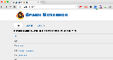
Azure Databricks Core ARTIFACTS
Clusters
Libraries
Workspaces
Azure Databricks
Jobs
Notebooks

Slide 27
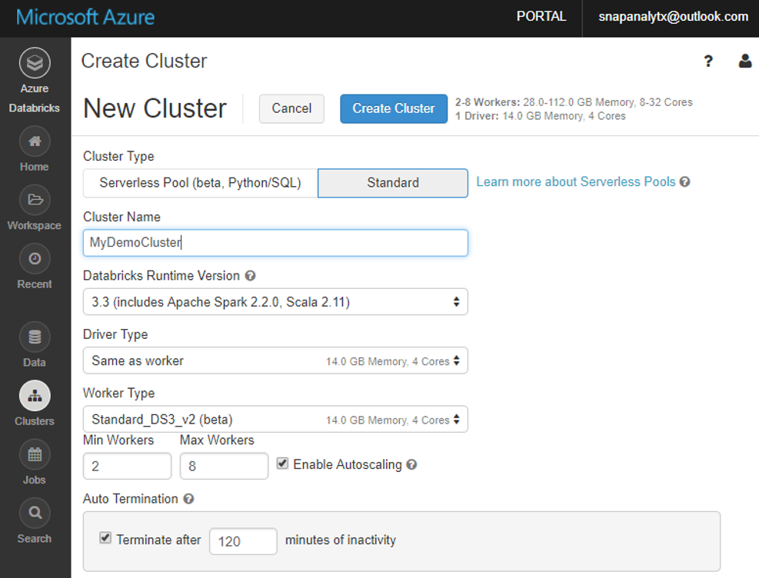
Clusters: Auto Scaling and Auto Termination
Simplifies cluster management and reduces costs by eliminating wastage
When creating Azure Databricks clusters you can choose Autoscaling and Auto Termination options.
Autoscaling: Just specify the min and max number of clusters. Azure Databricks automatically scales up or down based on load.
Auto Termination: After the specified minutes of inactivity the cluster is automatically terminated.
Benefits:
You do not have to guess, or determine by trial and error, the correct number of nodes for the cluster
As the workload changes you do not have to manually tweak the number of nodes
You do not have to worry about wasting resources when the cluster is idle. You only pay for resource when they are actually being used
You do not have to wait and watch for jobs to complete just so you can shutdown the clusters

Slide 28
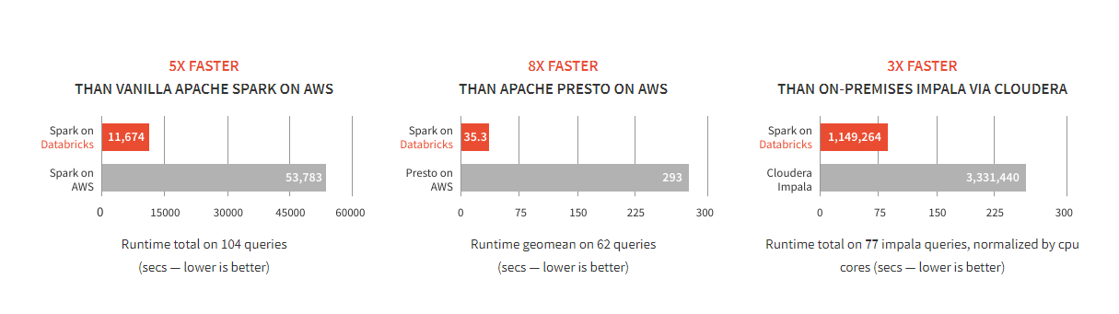
Databricks Spark is fast
Benchmarks have shown Databricks to often have better performance than alternatives
SOURCE: Benchmarking Big Data SQL Platforms in the Cloud

Slide 29
Modern Big Data Warehouse
Ingest
Store
Prep & Train
Model & Serve
Intelligence
Logs, files and media (unstructured)
Data factory
Azure storage
Azure Databricks
(Spark)
Business / custom apps
(Structured)
Polybase
Data factory
Azure SQL Data Warehouse
Analytical dashboards

Slide 30
Advanced Analytics on Big Data
Ingest
Store
Prep & Train
Model & Serve
Intelligence
Logs, files and media (unstructured)
Data factory
Azure storage
Azure Databricks
(Spark Mllib, SparkR, SparklyR)
Azure Cosmos DB
Web & mobile apps
Business / custom apps
(Structured)
Polybase
Data factory
Azure SQL Data Warehouse
Analytical dashboards

Slide 31
Real-time analytics on Big Data
Ingest
Store
Prep & Train
Model & Serve
Intelligence
Unstructured data
Azure HDInsight (Kafka)
Azure Databricks
(Spark)
Polybase
Azure storage
Azure SQL Data Warehouse
Analytical dashboards

Slide 32
Big Data OSS - Sales Guidance
Azure HDInsight (1st party + Support)
Azure Databricks (1st party + Support)
3rd Party Offerings
What it is
Hadoop (Hortonworks’ Distribution) as a managed service supporting a variety of open-source analytics engines such as Apache Spark, Hive LLAP, Storm, Kafka, HBase.
Security via Ranger (Kerberos based)
Pricing
Priced to compete with AWS EMR. Standard offering.
Sell When
Customer prefers a PaaS like experience to address big data use cases by working with different OSS analytics engines to address big data use cases. Cost sensitive.
Seller Compensation
Retires Azure Data Services consumption
What it is
Databricks Spark, the most popular open-source analytics engine, as a managed service providing an easy and fast way to unlock big data use cases. Offers best-in-class notebooks experience for productivity and collaboration as well integration with Azure Data Warehouse, Power BI, etc
Security via native Azure AD integration
Pricing
Priced to match Databricks on AWS. Premium offering.
Sell When
Customer prefers SaaS like experience to address big data use cases and values Databricks’ ease of use, productivity & collaboration features.
Seller Compensation
Retires Azure Data Services & Azure consumption
What it is
Hadoop distributions from Cloudera, MapR & Hortonworks available on Azure Marketplace as IaaS VMs.
Pricing
N/A. Vendor prices their products.
Sell When
Customer wants to move their on premises Hadoop distribution to Azure IaaS using their existing licenses.
Seller Compensation
Retires Azure consumption

Slide 33
LOOKING ACROSS THE OFFERINGS
Azure HDInsight
What It Is
Hortonworks distribution as a first party service on Azure
Big Data engines support – Hadoop Projects, Hive on Tez, Hive LLAP, Spark, HBase, Storm, Kafka, R Server
Best-in-class developer tooling and Monitoring capabilities
Enterprise Features
VNET support (join existing VNETs)
Ranger support (Kerberos based Security)
Log Analytics via OMS
Orchestration via Azure Data Factory
Available in most Azure Regions (27) including Gov Cloud and Federal Clouds
Guidance
Customer needs Hadoop technologies other than, or in addition to Spark
Customer prefers Hortonworks Spark distribution to stay closer to OSS codebase and/or ‘Lift and Shift’ from on-premises deployments
Customer has specific project requirements that are only available on HDInsight
Azure Databricks
What It Is
Databricks’ Spark service as a first party service on Azure
Single engine for Batch, Streaming, ML and Graph
Best-in-class notebooks experience for optimal productivity and collaboration
Enterprise Features
Native Integration with Azure for Security via AAD (OAuth)
Optimized engine for better performance and scalability
RBAC for Notebooks and APIs
Auto-scaling and cluster termination capabilities
Native integration with SQL DW and other Azure services
Serverless pools for easier management of resources
Guidance
Customer needs the best option for Spark on Azure
Customer teams are comfortable with notebooks and Spark
Customers need Auto-scaling and
Customer needs to build integrated and performant data pipelines
Customer is comfortable with limited regional availability (3 in preview, 8 by GA)
Azure ML
What It Is
Azure first party service for Machine Learning
Leverage existing ML libraries or extend with Python and R
Targets emerging data scientists with drag & drop offering
Targets professional data scientists with
Experimentation service
Model management service
Works with customers IDE of choice
Guidance
Azure Machine Learning Studio is a GUI based ML tool for emerging Data Scientists to experiment and operationalize with least friction
Azure Machine Learning Workbench is not a compute engine & uses external engines for Compute, including SQL Server and Spark
AML deploys models to HDI Spark currently
AML should be able to deploy Azure Databricks in the near future

Slide 34
Cosmos DB

Slide 35
Relational Databases vs Non-Relational Databases (NoSQL) vs Hadoop
RDBMS (SQL Server) for enterprise OLTP and ACID compliance, or db’s under 5TB
NoSQL (Cosmos DB) for scaled OLTP and JSON documents
Hadoop for big data analytics (OLAP) or Data Lake
(from my presentation “Relational Databases vs Non-Relational Databases”)

Slide 36

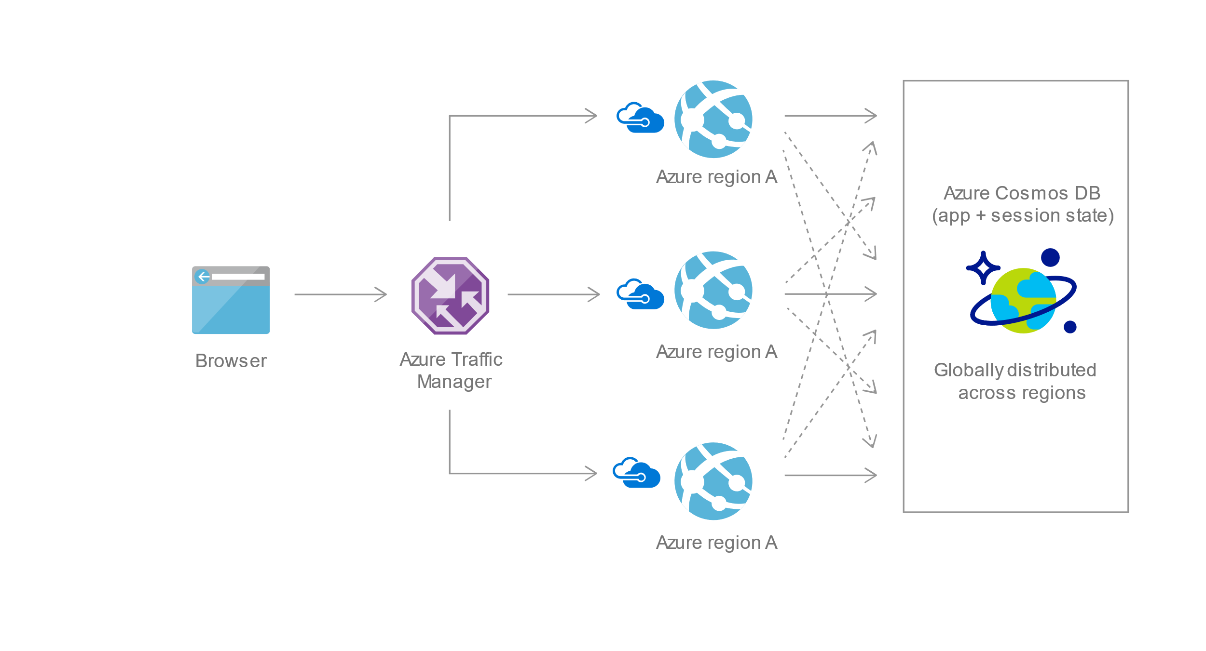
Domino’s Pizza delivers through globally-distributed apps
Globally-distributed mission-critical apps
Tech-centric consumers across continents demand instant access and uninterrupted service
99.99% uptime
Millisecond load latency
Globally distributed order-processing

Slide 37


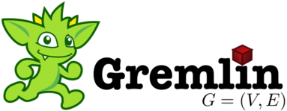



Azure Cosmos DB
A globally distributed, massively scalable, multi-model database service
Table API
MongoDB API
Cassandra API
Column-family
Document
Key-value
Graph
Elastic scale out
of storage & throughput
Guaranteed low latency at the 99th percentile
Five well-defined consistency models
Turnkey global distribution
Comprehensive SLAs
Notes:
Azure Cosmos DB offers the first globally distributed, multi-model database service for building planet scale apps. It’s been powering Microsoft’s internet-scale services for years, and now it’s ready to launch yours.
Only Azure Cosmos DB makes global distribution turn-key.
You can add Azure locations to your database anywhere across the world, at any time, with a single click. Cosmos DB will seamlessly replicate your data and make it highly available.
Cosmos DB allows you to scale throughput and storage elastically, and globally! You only pay for the throughput and storage you need – anywhere in the world, at any time.

Slide 38
Introducing Azure Cosmos DB A globally distributed, massively scalable, multi-model database service
Automatically replicate all your data around the world – across more regions than Amazon and Google combined
Global distribution
Available in all Azure regions
Multi-homing APIs
Comprehensive SLA
Manual and automatic failover
Automatic & synchronous multi-region replication
Notes:
So, how does Azure Cosmos DB enable applications to achieve this. Cosmos DB is built as a globally distributed database from the ground up. Every database account can be associated with any number of Azure regions and the data will replicate data automatically, synchronously, and durably .
Azure Cosmos DB powers Microsoft’s mission critical applications and it took many years of in its making. Within a given region, all resources are horizontally partitioned using resource partitions (local distribution). Each resource partition is also replicated across geographical regions (global distribution).
Cosmos DB is a Foundational (Ring 0) Azure service
Available in all Azure regions by default, including sovereign/government clouds
Transparent and automatic multi-region replication
Associate any number of regions with your database account, at any time
Policy based geo-fencing
Multi-homing APIs
All endpoints are logical, by default
Apps don’t need to be redeployed during regional failover
Apps can also access physical endpoints if needed
Support for both manual and automatic failover
Designed for high availability
Allows for dynamically setting priorities to regions
Simulate regional disasters via API
Test the end-to-end availability for the entire app (beyond just the database)
Comprehensive SLAs
First and only to offer comprehensive SLA for latency, throughput, availability and consistency

Slide 39


Introducing Azure Cosmos DB A globally distributed, massively scalable, multi-model database service
Independently and elastically scale storage and throughput across regions
Global distribution
Elastic scale-out
Notes:
Cosmos DB is designed for customer to elastically scale throughput based on the application traffic patterns across different geographical regions to support fluctuating workloads varying both by geography and time. The system manages the partitions transparently without compromising the availability, consistency, latency or throughput of a Cosmos DB container. Throughput can be scaled from 100’s of requests/sec to several 100s of million requests/sec. Customers pay only for the throughput they need.

Slide 40
Introducing Azure Cosmos DB A globally distributed, massively scalable, multi-model database service
Serve <10 ms read and <15 ms write requests at the 99th percentile from the nearest region while delivering data globally
Global distribution
Elastic scale-out
Guaranteed single-digit latency
Guaranteed global millisecond latency at the 99th percentile
Notes:
Cosmos DB guarantees low latency access by serving reads and writes from the local regions. This helps your applications to beat the speed of light or network latency across regions.
Nucleus of Cosmos DB is a write optimized, latch-free database engine which is designed for Solid State Drives. The core design point is low latency and performance and global scale.
Cosmos DB indexes all your data automatically, synchronously at sustained ingestion rates. There is no overhead of secondary indexes as with other databases. Most of us know the pain of managing indexes. Now imagine for a moment maintaining, managing, migrating indexes at global scale. It is almost impossible but with Azure Cosmos DB, you don’t have to. At P99 Cosmos DB guarantees <10ms latency for read access and <15ms for write access. Most applications will experience even lower latency of under <2ms for reads and <6ms for writes.
Several of our large scale cloud services at Microsoft uses Cosmos DB for low latency access. All the device telemetry from windows mobile devices is stored in a globally distributed database and with 100s of millions of devices out there, low latency was a key factor in deciding on the right data store.

Slide 41
Introducing Azure Cosmos DB A globally distributed, massively scalable, multi-model database service
Choose from five defined consistency levels for low latency and high availability
Global distribution
Elastic scale-out
Guaranteed single-digit latency
Strong
Bounded-stateless
Session
Consistent prefix
Eventual
Choice of consistency
Notes:
Cosmos DB exposes multiple well-defined consistency models: Databases today only offer two extreme choices for consistency – “strong” consistency and “eventual” consistency. In contrast, Cosmos DB is the first production globally distributed database service to have harvested a set of useful consistency models from decades of research and have operationalized them. Cosmos DB offers five well-defined consistency models which provide clear tradeoffs with respect to latency/availability, backed by SLAs.
While most database services force you to choose between strong or eventual consistency, Azure Cosmos DB provides multiple well-defined, intuitive consistency choices – so you can select just the right one for your app.
Lets discuss the Cosmos DB - 5 well-defined, precise, consistency models to choose from
Consistency Levels and guarantees
Consistency LevelGuarantees
Strong – Linearizability
Bounded Staleness - Reads lag behind writes by k prefixes or t interval
Session - Monotonic reads, monotonic writes, read-your-writes, write-follows-reads
Consistent Prefix - Updates returned are some prefix of all the updates, with no gaps
EventualOut of order reads
You can change your choice anytime via API
You can override it on a per request basis
ACID Transactions
All read and write requests are wrapped in a transactions
Language integrated batch transactions
Snapshot isolation by default

Slide 42
Introducing Azure Cosmos DB A globally distributed, massively scalable, multi-model database service
Only service with financially-backed SLAs for millisecond latency at the 99th percentile, 99.99% HA and guaranteed throughput and consistency
Global distribution
Elastic scale-out
Latency
Throughput
Choice of consistency
<10ms
HA
Consistency
Guaranteed
99th percentile
Guaranteed single-digit latency
99.99%
Guaranteed
Enterprise-level SLAs
Notes:
Only service with financially-backed SLAs for millisecond latency at the 99th percentile, 99.99% HA and guaranteed throughput and consistency
Globally distributed database needs to tackle
latency vs. consistency tradeoffs (in steady state)
availability vs. consistency tradeoff (during failures)
throughput vs. consistency tradeoffs during all times
throughput vs. latency tradeoffs during all times
Simply offering high availability SLAs are not sufficient!
Cosmos DB:
99.99% HA within a single region
99.999% across regions
99.99 SLA throughput, latency, consistency

Slide 43

Introducing Azure Cosmos DB A globally distributed, massively scalable, multi-model database service
Use key-value, graph, and document with a schema-agnostic service that doesn’t require any schema or secondary indexes
Global distribution
Elastic scale-out
Guaranteed single-digit latency
KEY-VALUE
COLUMN-FAMILY
Choice of consistency
Enterprise-level SLAs
DOCUMENT
GRAPH
Multi-model + multi API
Notes:
Cosmos DB allows developers to model real world in its true form: No data is born relational. Cosmos DB allows developers to store and query their data in its original form. It exposes graph, documents, key-values, column-family data models and will enable others. The multi-model and multi-API capabilities remove the friction, allowing you to build with any data model and API.
Cosmos DB meets developers where they are: Cosmos DB offers a multitude of APIs to access and query data including, SQL and various popular OSS APIs.
(APIs including SQL (Document DB), JavaScript, Gremlin, MongoDB, and Azure Table storage to query your data.- More to come.)

Slide 44
Azure SQL Database Managed Instance

Slide 45
Introducing Azure SQL Database Managed Instance
Managed Instance
Instance scoped programming model with high compatibility to on-premises databases
Single
Standalone managed database best for predictable and stable workloads
Elastic pool
Shared resource model best for greater efficiency through multi-tenancy
Best for modernization at scale with low cost and effort
Notes:
With digital transformation in mind, let’s focus on how SQL Database provides the low-cost, low-friction option to migrating your SQL Server data at scale to SQL Database – without having to re-architect your apps.
Introducing Azure SQL Database Managed Instance
SQL Database Managed Instance is an expansion of the existing SQL Database service designed to enable database lift-and-shift to a fully-managed PaaS, without re-designing the application. SQL Database Managed Instance provides high compatibility with the on-premises SQL Server programming model and out-of-box support for the large majority of SQL Server features and accompanying tools and services.
It’s important to note that Managed Instance isn’t a new service – it is a third deployment option within Azure SQL Database, sitting alongside single databases and elastic pools. As part of Azure SQL Database, Microsoft’s fully managed cloud database service, it inherits all its built-in PaaS features.

Slide 46
What is SQL Database Managed Instance?
SQL Database (PaaS)
A flavor of SQL DB designed to enable easy migration to fully managed PaaS, for almost any application!
Managed Instance
Singleton
Elastic Pool
Easy lift and shift
Fully managed PaaS
Full isolation and security
New business model
Fully-fledged SQL instance with nearly 100% compat with on-prem
Built on the same PaaS service infrastructure
All PaaS features
Native VNET implementation
Private IP addresses
Competitive
Transparent
Frictionless

Slide 47
Focus on your business…
Managed Instance will offer all these features by GA!
Your work so far | How PaaS helps?
Hardware purchasing and management | Built-in Scales on-demand
Protect data with backups (with health checks and retention) | Built-in Point-In-Time-Restore
High availability implementation | Built-in 99.99% SLA and auto-failover
Disaster recovery implementation | Built-in Geo-redundancy and geo-replication
Ensure compliance with standards on your own | Built-in / easy to use features
Secure your data from malicious users and mistakes | Built-in / easy to use features
Role out updates and upgrades | Built-in
Monitor, troubleshoot and manage at scale | Built-in / easy to use features
Tune and maintain for predictable performance | Built-in/ easy to use features

Slide 48
IAAS vs PAAS
Relational Database Engines
SQL Server in Azure VM
Azure SQL Database Managed Instance
Azure SQL Database
^{NEW*}
It’s a VM!
Migrate Fleet of Databases
Fully managed Database
Management of OS and SQL Server
Security Isolation with Azure VNet
Active Learning and Optimization
Select Version, OS, Edition
Application Surface Compatibility SQL Agent, Profiler Cross DB querying, CLR, Replication, CDC, Service Broker
End to End Integration
Single VM availability SLA: 99.9% (<43 min downtime p/month)
Multi-VM availability SLA: 99.95% (<21 min downtime p/month)
Intelligent Data Protection & Security
Database sizes up to 35TB
Application & Data Modernization
Minimize Migration Downtime
Up to 4 TB single Databases > using Elastic Scale
All Azure SQL Database features
Geo-DR
Database availability SLA: 99.99%

Slide 49
Easy migration: nearly 100% like SQL Server
Data migration
Native backup/restore
Log shipping (DMS)
Security
TDE
SQL Audit
Row level security
Always Encrypted
Programmability
Global temp tables
Cross-database queries and transactions
Linked servers
CLR modules
Operational
DMVs & XEvents
Query Store
SQL Agent
DB Mail (external SMTP)
Scenario enablers
Service Broker
Change Data Capture
Transactional Replication
Supports compatibility modes (SQL Server 2005+)
Note: features will be added in stages until General Availability of Managed Instance

Slide 50


Backup/Restore to Managed Instances
Instance subnet
Front end subnet
3
REPOINT APP
SQL on VM
SQL Instance #1
2
RESTORE
1
BACKUP TO AZURE
storage account
This can be automated with the Azure Database Migration Service

Slide 51
Easy migration: Database Migration Service (DMS)
Fully managed, reliable and seamless, migration service for both operational databases and data warehouses
Minimal down time migrations
Homogeneous and heterogeneous source-target pairs
Public preview: SQL 2005+ to SQL DB / Managed Instance
Initial focus on reliability and performance
Iterative addition of source-target pairs
For more information, contact datamigrationteam@microsoft.com
SQL DB
Oracle
SQL
SQL

Slide 52
Easy migration: SSIS / SSAS / SSRS
Will not be installed side-by-side with Managed Instance
Recommendation: move to PaaS model
Migrate your SSIS packages to new SSIS on Azure Data Factory (PaaS service)
Migrate your OLAP models to Azure Analysis Services
… or run these services in Azure virtual machines
For SSRS: run in a virtual machine, or switch to Power BI

Slide 53
Azure Data Factory v2

Slide 54
ADF V2 Improvements
Integration Runtimes (IR) replace DMG, provide data movement and activity dispatch on-prem or in the cloud
Supports resources within virtual networks
Integration Runtime includes SSIS option to lift & shift SSIS packages to the Cloud
Separation of “control flow” & “data flow” capabilities for more flexible pipeline management
Looping, conditionals, dependencies, parameters
Python SDK
On-Demand Spark support
Flexible pipeline scheduling with wall-clock and triggered executions
Expanded use cases: From primarily time window-oriented pipelines, to trigger-based on-demand for more flexible ETL and data integration orchestrations
(Coming in GA) UX pipeline and data transformation builder code-free experience

Slide 55
New ADF V2 Concepts
Concept | Description | Sample
Control Flow | Orchestration of pipeline activities that includes chaining activities in a sequence, branching, conditional branching based on an expression, parameters that can be defined at the pipeline level and arguments passed while invoking the pipeline on demand or from a trigger. Also includes custom state passing and looping containers, I.e. For-each, Do-Until iterators. | { "name":"MyForEachActivityName", "type":"ForEach", "typeProperties":{ "isSequential":"true", "items":"@pipeline().parameters.mySinkDatasetFolderPathCollection", "activities":[ { "name":"MyCopyActivity", "type":"Copy", "typeProperties": …
Runs | A Run is an instance of the pipeline execution. Pipeline Runs are typically instantiated by passing the arguments to the parameters defined in the Pipelines. The arguments can be passed manually or properties created by the Triggers. | POST https://management.azure.com/subscriptions/<subId>/resourceGroups/<resourceGroupName>/providers/Microsoft.DataFactory/factories/<dataFactoryName>/pipelines/<pipelineName>/createRun?api-version=2017-03-01-preview
Activity Logs | Every activity execution in a pipeline generates activity start and activity end logs event
Integration Runtime | Replaces DMG as a way to move & process data in Azure PaaS Services, self-hosted or on prem or IaaS Works with VNETs Enables SSIS package execution | Set-AzureRmDataFactoryV2IntegrationRuntime -Name $integrationRuntimeName -Type SelfHosted
Scheduling | Flexible Scheduling Wall-clock scheduling Event-based triggers | "type": "ScheduleTrigger", "typeProperties": { "recurrence": { "frequency": <<Minute, Hour, Day, Week, Year>>, "interval": <<int>>, // optional, how often to fire (default to 1) "startTime": <<datetime>>, "endTime": <<datetime>>, "timeZone": <<default UTC>> "schedule": { // optional (advanced scheduling specifics) "hours": [<<0-24>>], "weekDays": ": [<<Monday-Sunday>>], "minutes": [<<0-60>>], "monthDays": [<<1-31>>], "monthlyOccurences": [ { "day": <<Monday-Sunday>>, "occurrence": <<1-5>>

Slide 56
New ADF V2 Concepts
Concept | Description | Sample
On-Demand Execution | Instantiate a pipeline by passing arguments as parameters defined in a pipeline and execute from script / REST / API. | Invoke-AzureRmDataFactoryV2PipelineRun -DataFactory $df -PipelineName "Adfv2QuickStartPipeline" -ParameterFile .\PipelineParameters.json
Parameters | Name-value pairs defined in the pipeline. Arguments for the defined parameters are passed during execution from the run context created by a Trigger or pipeline executed manually. Activities within the pipeline consume the parameter values. A Dataset is a strongly typed parameter and a reusable/referenceable entity. An activity can reference datasets and can consume the properties defined in the Dataset definition A Linked Service is also a strongly typed parameter containing the connection information to either a data store or a compute environment. It is also a reusable/referenceable entity. | Accessing parameters of other activities Using expressions @parameters(“{name of parameter}”) @activity(“{Name of Activity}”).output.RowsCopied
Incremental Data Loading | Leverage parameters and define your high-water mark for delta copy while moving dimension or reference tables from a relational store either on premises or in the cloud to load the data into the lake | name": "LookupWaterMarkActivity", "type": "Lookup", "typeProperties": { "source": { "type": "SqlSource", "sqlReaderQuery": "select * from watermarktable" }
On-Demand Spark | Support for on-demand HDI Spark clusters, similar to on-demand Hadoop activities in V1 | "type": "HDInsightOnDemand", "typeProperties": { "clusterSize": 2, "clusterType": "spark", "timeToLive": "00:15:00",
SSIS Runtime | Lift & shift, deploy, manage, monitor SSIS packages in the cloud with SSIS Azure IR Service in Azure Data Factory | Start-AzureRmDataFactoryV2IntegrationRuntime -DataFactoryName $DataFactoryName -Name

Slide 57
Patterns & Scenarios for ADF V2

Slide 58



Hybrid Data Integration Pattern 1: Analyze blog comments
Capture blog comments via API
Azure Data Factory
Azure SQL Database
Power BI Dashboard
Drop into Blob Store
Transform via SPROC (ELT)
Transform via Dataflow (ETL)
Visualize and analyze
Copy & lookup
Data Management
Gateway Req’d for ADF
SQL Server
(on-premises)

Slide 59
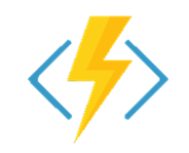
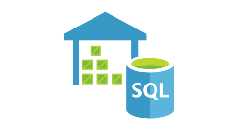


Hybrid Data Integration Pattern 2: Data-Driven SaaS App: Sentiment Analysis w/Machine Learning
Blob Storage
Loop through all files in folder
Azure Functions
Power BI
Azure Data Factory

Slide 60








Hybrid Data Integration Pattern 3: Modern Data Warehouse
Scheduling
Pipeline / Job Monitoring
Pipeline / Job Management
Transform, Combine, etc
Power BI (Visualize)
Daily flat files
Analyze
Move
On Demand
OLTP DB Tables
On Premises
SQL/Oracle
Social Media (un/semi structured)
Customer Call Details
AML: Churn Model
Azure Blob Storage
Analytical Schemas
Azure DW
Azure Data Factory (PaaS)

Slide 61
ADFv2: Control Flow
Coordinate pipeline activities into finite execution steps to enable looping, conditionals and chaining while separating data transformations into individual data flows
My Pipeline 1
For Each…
My Pipeline 2
Trigger
Event
Wall Clock
On Demand
Success, params
Activity 1
Success, params
Activity 2
Activity 3
Activity 1
Activity 4
Activity 2
Error, params
“On Error” Activity 1
…
…

Slide 62
Integration Runtime

Slide 63


ADF Integration Runtime (IR)
ADF compute environment with multiple capabilities:
Activity dispatch & monitoring
Data movement
SSIS package execution
To integrate data flow and control flow across the enterprises’ hybrid cloud, customer can instantiate multiple IR instances for different network environments:
On premises (similar to DMG in ADF V1)
In public cloud
Inside VNet
Bring a consistent provision and monitoring experience across the network environments
Portal Application & SDK
Azure Data Factory Service
Self-Hosted IR
Azure IR
Data Movement & Activity Dispatch on-prem, Cloud, VNET
Data Movement & Activity Dispatch In Azure Public Network, SSIS
VNET coming soon

Slide 64



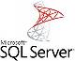






Command & Control
Data Flow
UX & SDK
Authoring | Monitoring/Mgmt
Azure Data Factory Service
Scheduling | Orchestration | Monitoring
On Premises Apps & Data
Cloud Apps, Svcs & Data

Slide 65
Command & Control
Data Flow
UX & SDK
Authoring | Monitoring/Mgmt
Azure Cloud
Azure Data Factory Service
Scheduling | Orchestration | Monitoring
PaaS Cloud Host
Integration Runtime
On Premises Apps & Data
Cloud Apps, Svcs & Data

Slide 66

Command & Control
Data Flow
UX & SDK
Authoring | Monitoring/Mgmt
Azure Cloud
Azure Data Factory Service
Scheduling | Orchestration | Monitoring
PaaS Cloud Host
Integration Runtime
Installable Agent
Integration Runtime
On Premises Apps & Data
Cloud Apps, Svcs & Data

Slide 67
Command & Control
Data Flow
UX & SDK
Authoring | Monitoring/Mgmt
Azure Cloud
Azure Data Factory Service
Scheduling | Orchestration | Monitoring
PaaS Cloud Host
Integration Runtime
Integration Runtime
- Activity Dispatch/Monitor (spark, copy, ml, etc)
- Data Movement
- SSIS Package Execution
Installable Agent
Integration Runtime
On Premises Apps & Data
Cloud Apps, Svcs & Data

Slide 68
Azure Data Factory “Integration Runtime” deployed on premises for transformation and then moved to cloud
Customer 1
Customer 1 firewall border
“IR”
ADF Foo On-prem

Slide 69
Azure Data Factory “Integration Runtime” deployed inside VNet
Customer 2
Customer 2 firewall border
Customer 2 vnet
“IR”
ADF Foo in vnet

Slide 70
SSIS in ADF

Slide 71


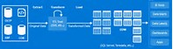
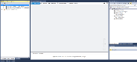
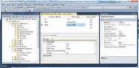
SSIS as an Integration Runtime
Provision SSIS IR via Data Factory
Use SQL Server Data Tools (SSDT) to author/deploy SSIS packages
Use SQL Server Management Studio (SSMS) to execute/manage SSIS packages
Target SSIS customers who want to move all/part of their on-premises workloads and just “lift & shift” many existing packages to Azure
Independent Software Vendors (ISVs) can build extensions/Software as a Service (SaaS) on SSIS Everest
ML
HDI
Provision
SSIS IR on ADF compute resource
Cloud
Azure Data Factory V2
On-Premises
Author/Deploy
Execute/Manage
SSDT
SSMS
Author/Deploy
SSIS Server
Execute/Manage

Slide 72
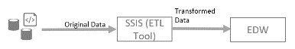
Traditional ETL
1. SSIS on Prem (to SQL Svr)
Lift & Shift w/ compatibility
2. SSIS on IaaS (to SQL on IaaS | Az DB)
Want PaaS benefits (scale, no VM mgmt, etc)
Mix reuse & modernization
3. SSIS Runtime in ADF
Trigger
SSIS Package A
SSIS Package “As-is”

Slide 73
Traditional ETL
1. SSIS on Prem (to SQL Svr)
Lift & Shift w/ compatibility
2. SSIS on IaaS (to SQL on IaaS | Az DB)
Want PaaS benefits (scale, no VM mgmt, etc)
Mix reuse & modernization
3. SSIS Runtime in ADF
Trigger
SSIS Package A
SSIS Package “As-is”
Trigger
Copy
SSIS Pkg A
AML
…
SSIS Package “Reuse”
Trigger
Copy
Spark
AML
…
Transform “@Scale”

Slide 74
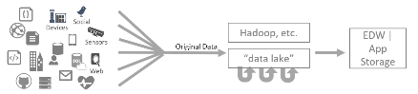
Traditional ETL
Modern DW & Data Driven SaaS
1. SSIS on Prem (to SQL Svr)
1. ADF V1 (Time-series, Tumbling Window)
(scenarios: log processing, etc.)
Lift & Shift w/ compatibility
2. SSIS on IaaS (to SQL on IaaS | Az DB)
Migrate v1 to v2:
Much more flexible model
Similar or cheaper in many scenarios
Want PaaS benefits (scale, no VM mgmt, etc)
Mix reuse & modernization
3. SSIS Runtime in ADF
2. ADF v2 (PaaS: Control Flow, Data Flow)
Trigger
SSIS Package A
SSIS Package “As-is”
Trigger
Copy
SSIS Pkg A
AML
…
SSIS Package “Reuse”
Trigger
Copy
Spark
AML
…
Transform “@Scale”

Slide 75
Q & A
?
James Serra, Big Data Evangelist
Email me at: JamesSerra3@gmail.com
Follow me at: @JamesSerra
Link to me at: www.linkedin.com/in/JamesSerra
Visit my blog at: JamesSerra.com (where this slide deck is posted via the “Presentations” link on the top menu)

